Slide 1
Learning Objective
I will be able to apply the order of operations on polynomials and factorise polynomials
Success Criteria
At the end of the lesson, I will be able to:
Add, subtract, multiply and divide polynomials
Solve equations involving cubic and quartic polynomials
Factorise polynomials

Slide 2
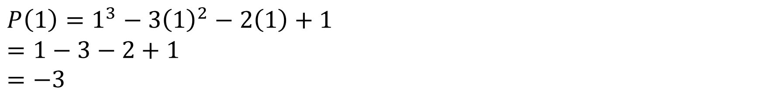
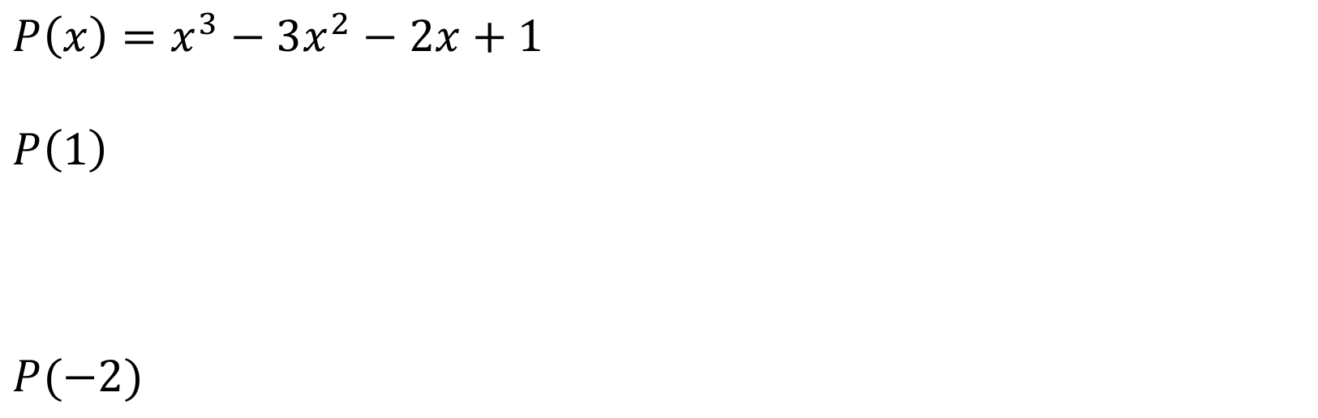
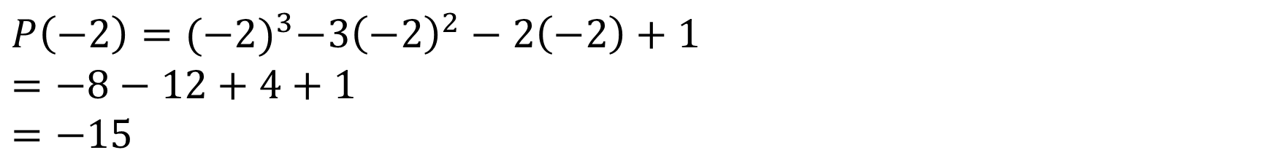
Guided Practice
$$P\left(x\right)=x^{3}−3x^{2}−2x+1$$
$$P\left(1\right)$$
$$P(−2)$$
$$P\left(1\right)=1^{3}−3{\left(1\right)}^{2}−2\left(1\right)+1 \\ =1−3−2+1 \\ =−3$$
$$P\left(−2\right)={(−2)}^{3}−3{\left(−2\right)}^{2}−2\left(−2\right)+1 \\ =−8−12+4+1 \\ =−15$$

Slide 3
Guided Practice
Let $P\left(x\right)=x^{3}+5x^{2}−ax−20$. If $P\left(2\right)=0,$ find the value of $a$
$$P\left(2\right)={(2)}^{3}+5{\left(2\right)}^{2}−a\left(2\right)−20$$
$$0={(2)}^{3}+5{\left(2\right)}^{2}−a\left(2\right)−20$$
$$8+20−2a−20=0$$
$$2a=8 \\ a=4$$

Slide 4
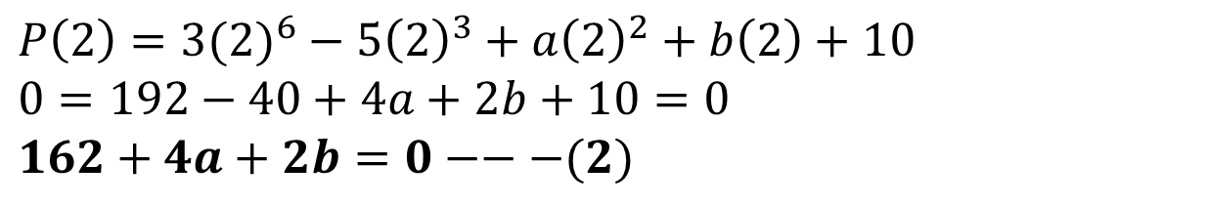
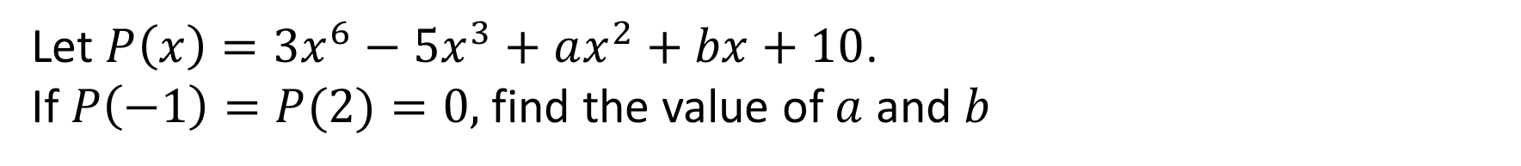
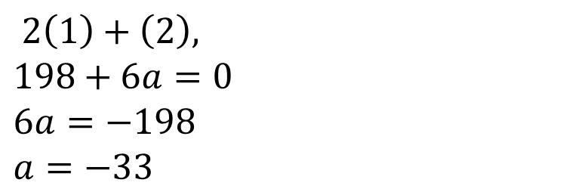
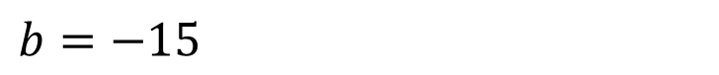
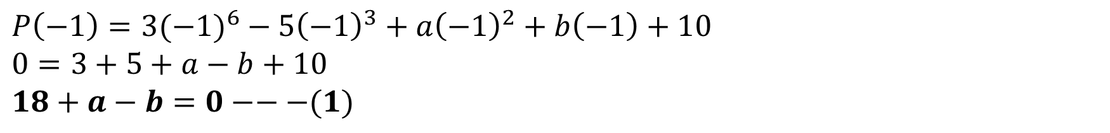
Guided Practice
Let $P\left(x\right)={3x}^{6}−5x^{3}+ax^{2}+bx+10$. If $P\left(−1\right)=P(2)=0,$ find the value of $a$ and $b$
$$P\left(−1\right)={3(−1)}^{6}−5{\left(−1\right)}^{3}+a{\left(−1\right)}^{2}+b\left(−1\right)+10 \\ 0=3+5+a−b+10 \\ 18+a−b=0−−−(1)$$
$$P\left(2\right)={3(2)}^{6}−5{\left(2\right)}^{3}+a{\left(2\right)}^{2}+b\left(2\right)+10 \\ 0=192−40+4a+2b+10=0 \\ 162+4a+2b=0−−−(2)$$
$$2\left(1\right)+\left(2\right), \\ 198+6a=0 \\ 6a=−198 \\ a=−33$$
$$b=−15$$
$$P\left(x\right)=3x^{6}−5x^{3}−33x^{2}−15x+10$$

Slide 5
Guided Practice
Expand $\left(x−2\right)\left(x^{2}−2x+3\right)$
$$x^{3}−2x^{2}+3x−2x^{2}+4x−6 \\ x^{3}−4x^{2}+7x−6$$

Slide 6
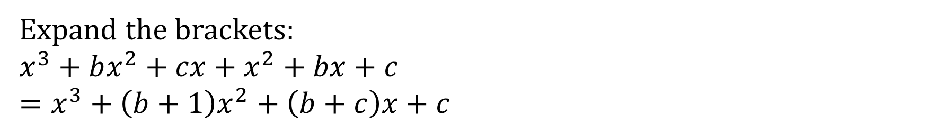
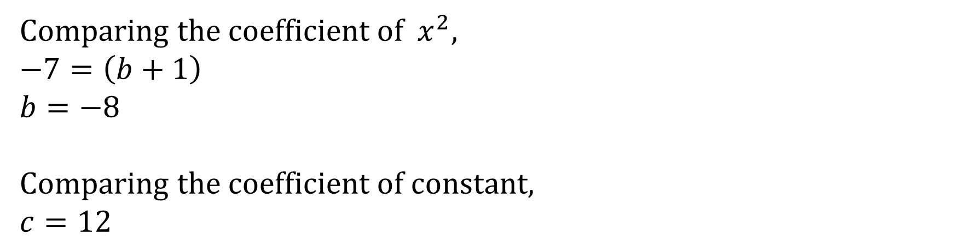
Guided Practice
If $x^{3}−7x^{2}+4x+12=\left(x+1\right)\left(x^{2}+bx+c\right),$ find $b, c$.
Expand the brackets:
$$x^{3}+bx^{2}+cx+x^{2}+bx+c \\ =x^{3}+\left(b+1\right)x^{2}+\left(b+c\right)x+c$$
$$x^{3}−7x^{2}+4x+12=x^{3}+\left(b+1\right)x^{2}+\left(b+c\right)x+c$$
Comparing the coefficient of $x^{2},$
$$−7=\left(b+1\right) \\ b=−8$$
Comparing the coefficient o$f constant,$ $$c=12$$

Slide 7
Guided Practice
Divide $x^{3}−4x^{2}+7x−6 \text{by} \left(x−2\right)$

Slide 8
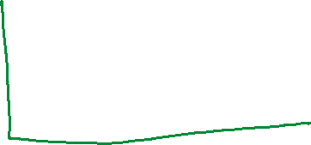

Guided Practice
Divide $x^{3}+x^{2}−14x−24 \text{by} \left(x+2\right)$ and then factorise fully

Slide 9
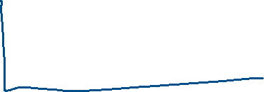
Guided Practice
Divide $x^{3}−7x−6 \text{by} \left(x+1\right)$

Slide 10
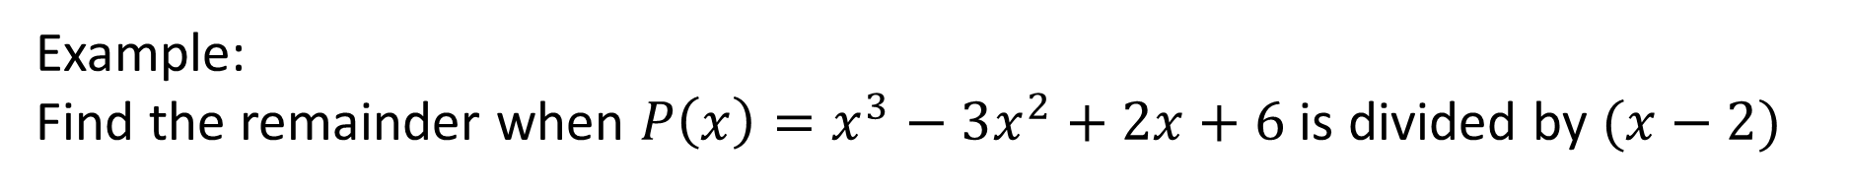

Concept Development
Remainder Theorem:
When $P\left(x\right)$ is divided by $ax+b,$ the remainder is $P\left(−\frac{b}{a}\right)$
Example:
Find the remainder when $P\left(x\right)=x^{3}−3x^{2}+2x+6$ is divided by $(x−2)$

Slide 11

Guided Practice
Remainder Theorem:
When $P\left(x\right)$ is divided by $ax+b,$ the remainder is $P\left(−\frac{b}{a}\right)$
Example:
Find the remainder when $P\left(x\right)=x^{3}−2x+4$ is divided by $(2x+1)$

Slide 12

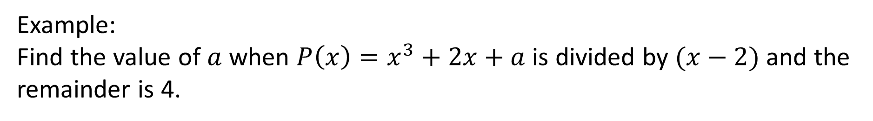
Guided Practice
Remainder Theorem:
When $P\left(x\right)$ is divided by $ax+b,$ the remainder is $P\left(−\frac{a}{b}\right)$
Example:
Find the value of $a$ when $P\left(x\right)=x^{3}+2x+a$ is divided by $(x−2)$ and the remainder is 4.

Slide 13

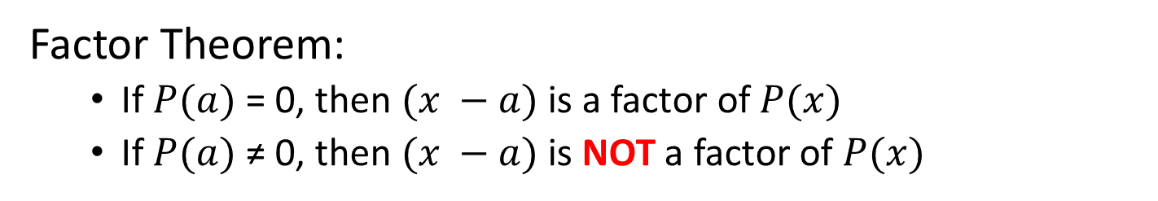
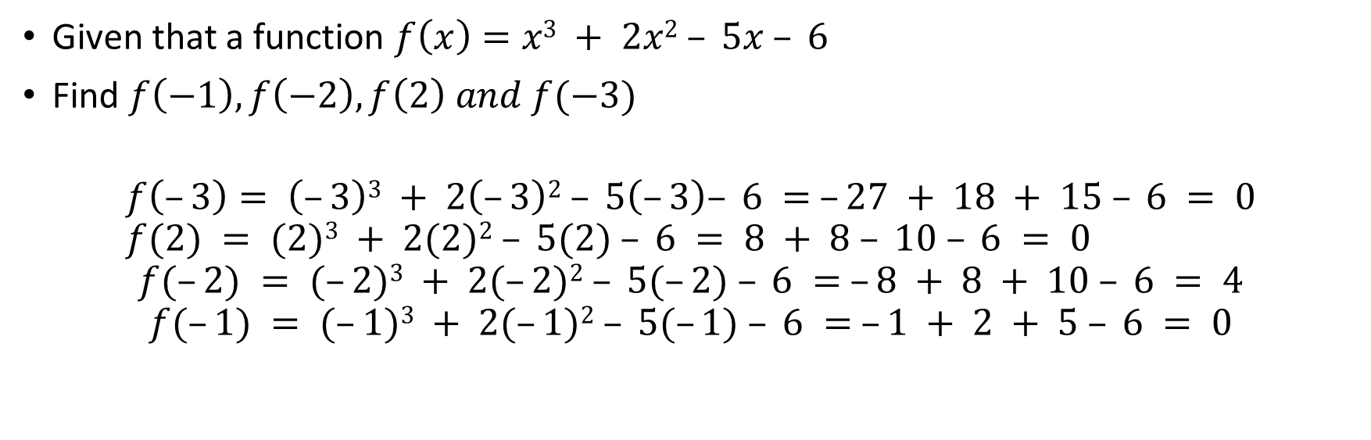



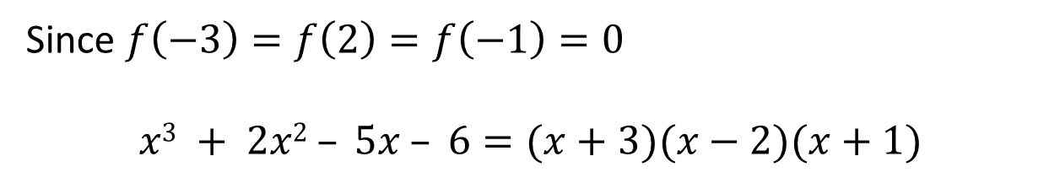

For any polynomial $P(x)$
Concept Development
Factor Theorem:
If $P(a)$= 0, then $(x −a)$is a factor of $P(x)$
If $P(a)$≠ 0, then $(x −a)$is NOT a factor of $P(x)$
Given that a function $f\left(x\right)=x3 + 2x2 – 5x – 6$
Find $f\left(−1\right),f\left(−2\right),f\left(2\right) and f(−3)$
$$f\left(–3\right)= \left(–3\right)3 + 2\left(–3\right)2 – 5\left(–3\right)– 6 = –27 + 18 + 15 – 6 = 0 \\ f(2) = (2)3 + 2(2)2 – 5(2) – 6 = 8 + 8 – 10 – 6 = 0$$
$$f(–2) = (–2)3 + 2(–2)2 – 5(–2) – 6 = –8 + 8 + 10 – 6 = 4$$
$$f(–1) = (–1)3 + 2(–1)2 – 5(–1) – 6 = –1 + 2 + 5 – 6 = 0$$
Since $f\left(−3\right)=f\left(2\right)=f\left(−1\right)=0$
$$x3 + 2x2 – 5x – 6=(x+3)(x−2)(x+1)$$

Slide 14
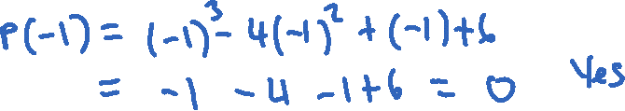


Guided Practice
Determine if $\left(x+1\right)$ is a factor of $x^{3}−4x^{2}+x+6$. If so, factorise $x^{3}−4x^{2}+x+6$

Slide 15
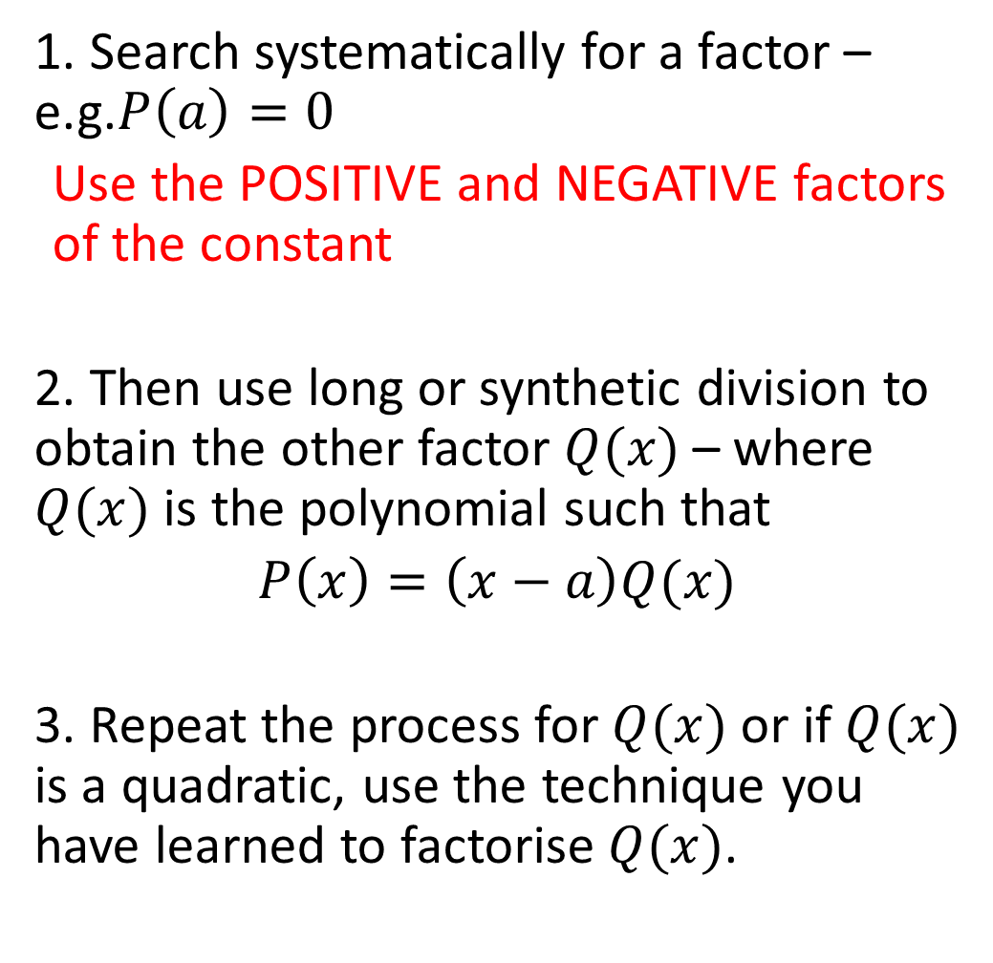
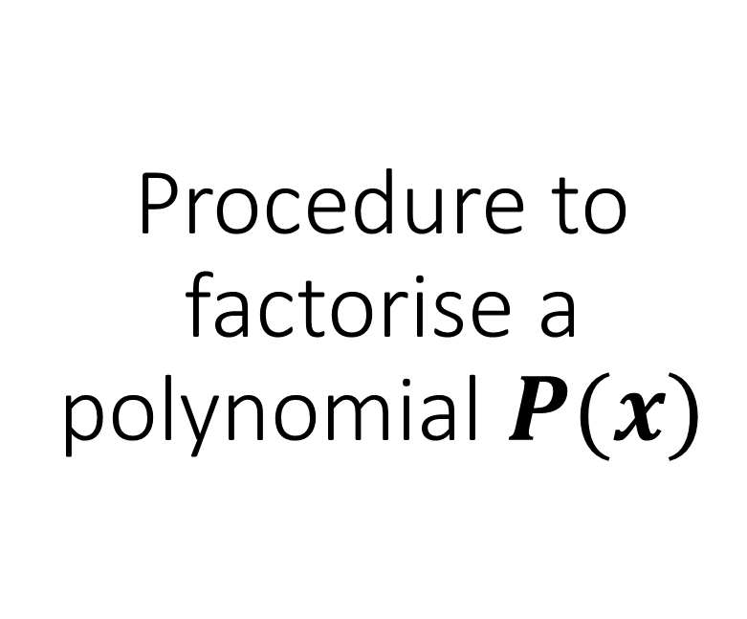
Procedure to factorise a polynomial $P(x)$
Concept Development
1. Search systematically for a factor – e.g.$P\left(a\right)=0$
Use the POSITIVE and NEGATIVE factors of the constant
2. Then use long or synthetic division to obtain the other factor $Q(x)$ – where $Q(x)$ is the polynomial such that
$$P\left(x\right)=\left(x−a\right)Q(x)$$
3. Repeat the process for $Q(x)$ or if $Q(x)$ is a quadratic, use the technique you have learned to factorise $Q(x)$.

Slide 16

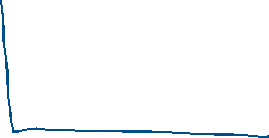
Guided Practice
Factorise $x^{3}+{2x}^{2}−5x−6$

Slide 17
Guided Practice
Factorise $x^{3}−{7x}^{2}+2x+40$

Slide 18
Guided Practice
Factorise $x^{3}−7x−6$

Slide 19







Guided Practice
Factorise ${2x}^{3}−{9x}^{2}+4x+15$

Slide 20




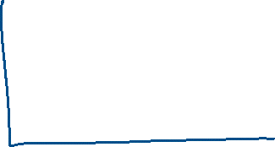
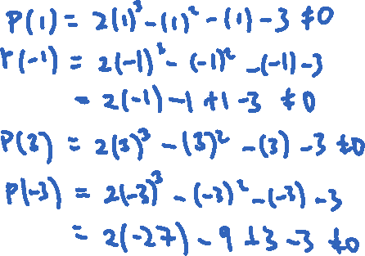
Guided Practice
Factorise ${2x}^{3}−x^{2}−x−3$

Slide 21

Guided Practice
Factorise ${3x}^{3}+8x^{2}+2x−5$

Slide 22

Concept Development
Factorise $x^{3}−27$

Slide 23

Concept Development
Factorise ${8x}^{3}+64$

Slide 24
Independent Practice
Complete Ex 7A & 7C
Skip 7B

